Slide 1
A Jigsaw Puzzle
By Team 2
Saurabh Somani
Shruthi Nagalapura Raghava
Shengtao Lin
Eric Castronovo
Rajas Purohit

Slide 2
Agenda
Problem Statement
Key Features
Designing our game
UML Diagrams
Demo
Lessons Learned
Project Management
Tools Used
Future Scope

Slide 3
Problem Statement
Our project is meant for people who love solving puzzles and competing with others.
Our project is a jigsaw puzzle that involves customizable levels with a variety of images.
Whoever plays our puzzle will be able to select the dimensions of the puzzle as well as the image that they are trying to complete.
At the end of the game there would be an option for the user to view the top ten players.

Slide 4
Key Features
Simple Registration
Intuitive UI
Multiple Levels
Generate Score
Scoreboard
Continued playing

Slide 5
Designing our game - OO Principles
Encapsulation
Private data members
GUI components of each screen are private
getters() and setters() have been used.
Modularity
Each class is designed for a specific task.
Each JPanel represents a different functionality.
3. Hierarchy
BoardManager will call all the JPanels
Represents HAS-A relationship here.
4. Abstraction
The user is taken through the screens without exposing the ugly complexities within.

Slide 6
Designing our game - Booch’s Principles
Stable Intermediate Forms
Each component of the game is standalone.
Together they constitute the overall system.
Hierarchical Structure
Hierarchy between single JFrame & JPanels
Also, PuzzlePanel class calls ActionListener (i.e. the event handler).
3. Separation of Concerns
Each JPanel is destined for a specific task.
User class always holds the updated user info
4. Finding Common Patterns
The JFrame is common across all screens and it is created by BoardManager class.

Slide 7
Designing our game - 5 C’s
Cohesion
Control moves from one class to other seamlessly.
User only sees the simple UI.
Clarity
Each & every class is defined for a specific task.
Completeness
Every class defined is
complete with all aspects.
4. Convenience
This has been ensured by modularity in code.
5. Consistency
The classes that have been designed are in sync with requirements by mapping with functional requirements.

Slide 8
Designing our game - Design Patterns
We have made use of the Strategy design pattern and the Singleton design pattern.
The size of the board and the image along with the number of buttons on the puzzle would be determined at runtime and instantiated, therefore these can be classified into Strategy design pattern.
The board which is the JFrame and also the object of the user class needs to be instantiated only once. Therefore, these follow the Singleton design pattern.

Slide 9
Designing our game - Anti-Patterns
We avoided the formation of GOD OBJECT in our system by separating the functionalities of a class.
Initially, we had the Score class which included the functionality of ScoreBoard (displays top ten scores) and ScoreMenu (displays the user’s score with a link to ScoreBoard screen).
We had to later separate these into two different classes to ensure separation of concerns.

Slide 10
Designing our game - Law of Demeter
Classes interact with other classes only when required.
For ex. the Login class interacts with the User class and stores the user information, MenuForm interacts with the PuzzlePanel to pass on the parameters selected by the users, similarly PuzzlePanel interacts with the ScoreMenu to pass on the details of the game played by user.
From the above explanation it is evident that any two classes would have limited knowledge about each other unless otherwise they are closed by.

Slide 11
Designing our game – Multi-Threading
We have made use of the concept of Multi-threading in our system by implementing the Timer API.
This is meant for keeping track of the time taken by the user to solve the puzzle successfully.
We see parallelism here, in the foreground user interacts with the puzzle and clicks on any two buttons to shuffle them, at the same time in the background the timer starts to record the time taken and simultaneously the number of moves would be recorded, in order to calculate the score.

Slide 12
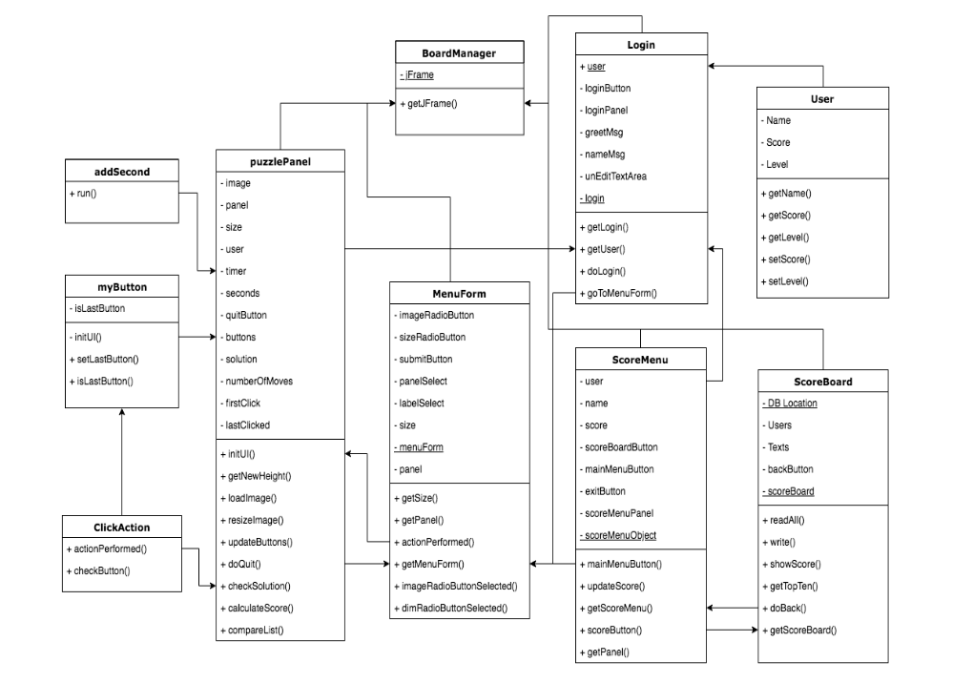
UML Diagrams - Class Diagram

Slide 13
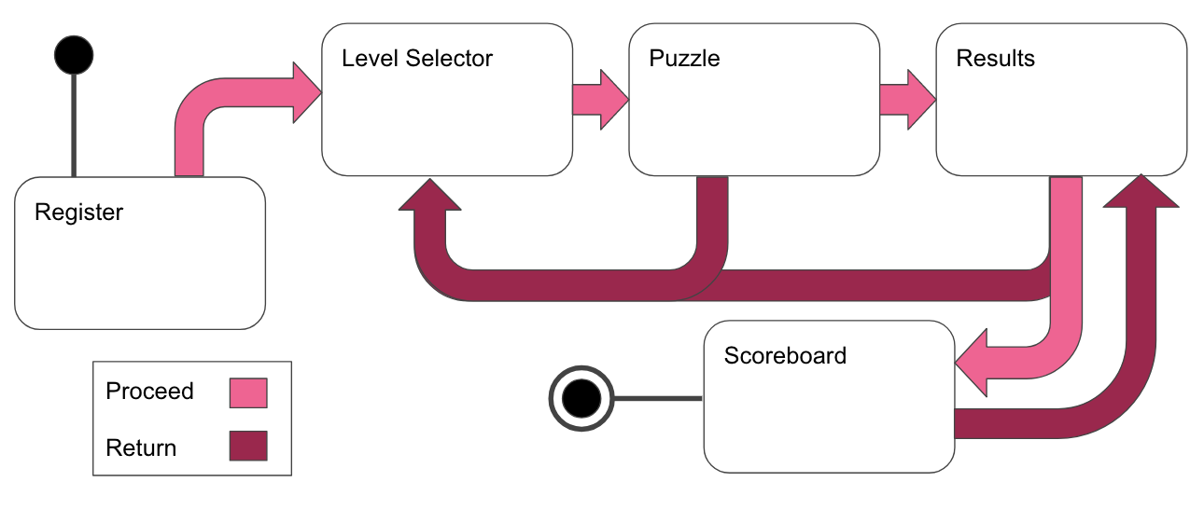
UML Diagrams - Flow Diagram

Slide 14
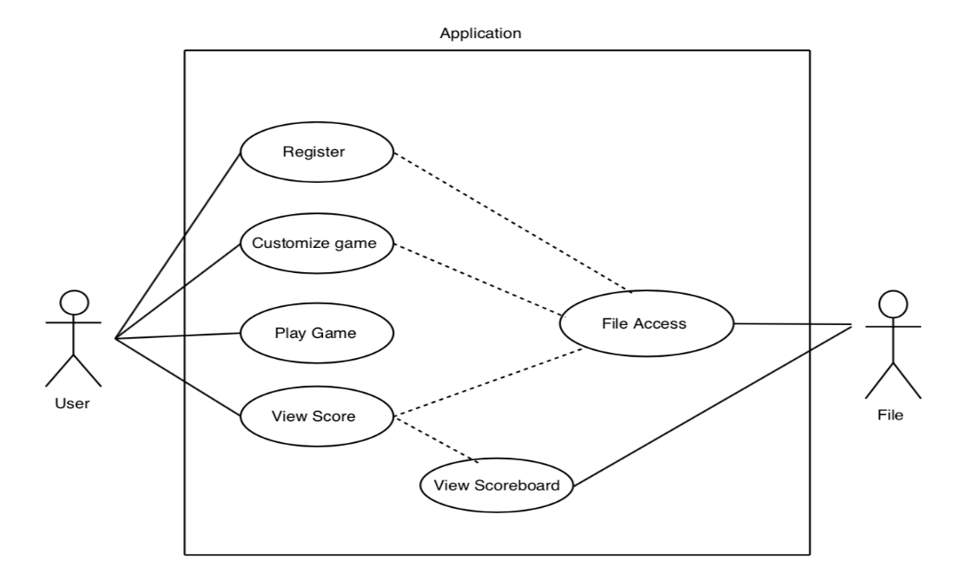
Designing our game - Use Case Diagram

Slide 15
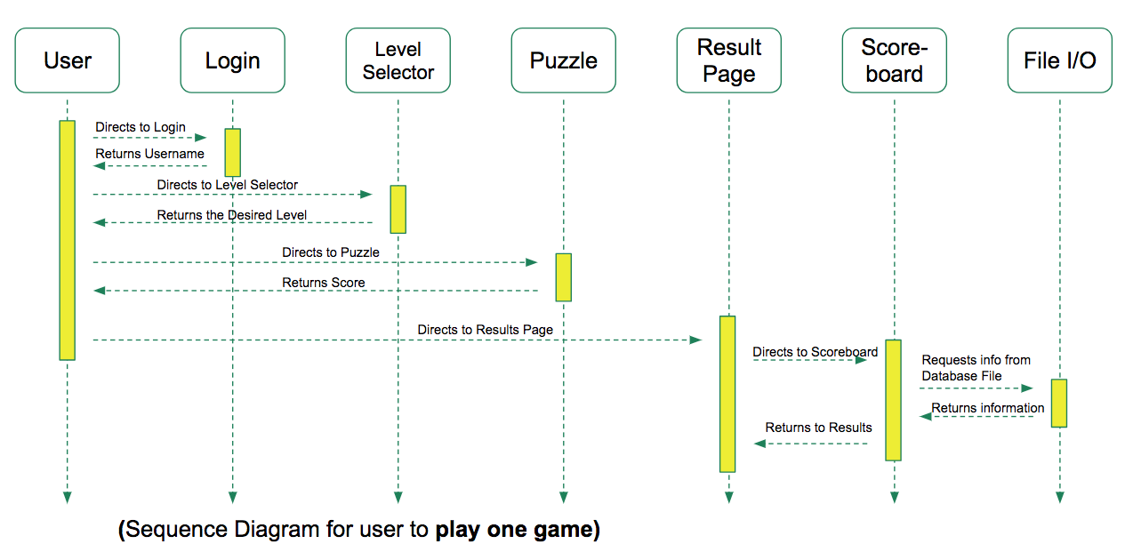
Designing our game - Sequence Diagram

Slide 16
Demo
Please hold while we switch to our demo

Slide 17
Lessons Learned
Take advantages of Java APIs
Tested and Proven
Reduces the workload
Start Small
Allows us to focus on the core requirements
Avoid falling short of promises
Create Mock-ups
Helps get the team get a visual of the game.
Continuous Integration
Helped us iron-out bugs faster

Slide 18
Project Management
Communication
Regular Meetings
WhatsApp
Dividing Tasks
UI
Layout Design
Development
Testing
Reporting
Time Management
Start early
Ask for help

Slide 19
Tools Used
Java Swing / AWT
Layout
JFrame, JPanels, etc.
2. Data Structures
Lists & Arraylists
3. File I/O
File Reader/ Writer
4. Image Cropping Tools
Crop image filter
5. Java IDE
Eclipse
Oxygen.3a
jdk version: 1.8.0_144

Slide 20
Future Scope
Sound effects
Adds another cool feature
Let’s us explore learn about Java Swing and Audio
Sign-in System
Allows us to have another user login
Level Tracker
Unlock more levels

Slide 21
At the end...
Constructed by:
Saurabh Somani
Shruthi Nagalapura Raghava
Shengtao Lin
Eric Castronovo
Rajas Purohit
Final Project For COEN 275 O.O.A.D.P
Santa Clara University
Graduate School of Engineering
Spring 2018

Slide 22
Thank You

